Slide 1

To-Do-List Project
By Tom Hoey

Slide 2

Design Specification
To create an OOP-based web application, with utilisation of supporting tools, methodologies, technologies, that encapsulates all fundamental and practical modules covered during training.
Key Areas:
Back-End in Java to handle information inputted from front-end.
Using Sprint Boot to handle API to Database.
Front-End using HTML, CSS, and JavaScript.

Slide 3
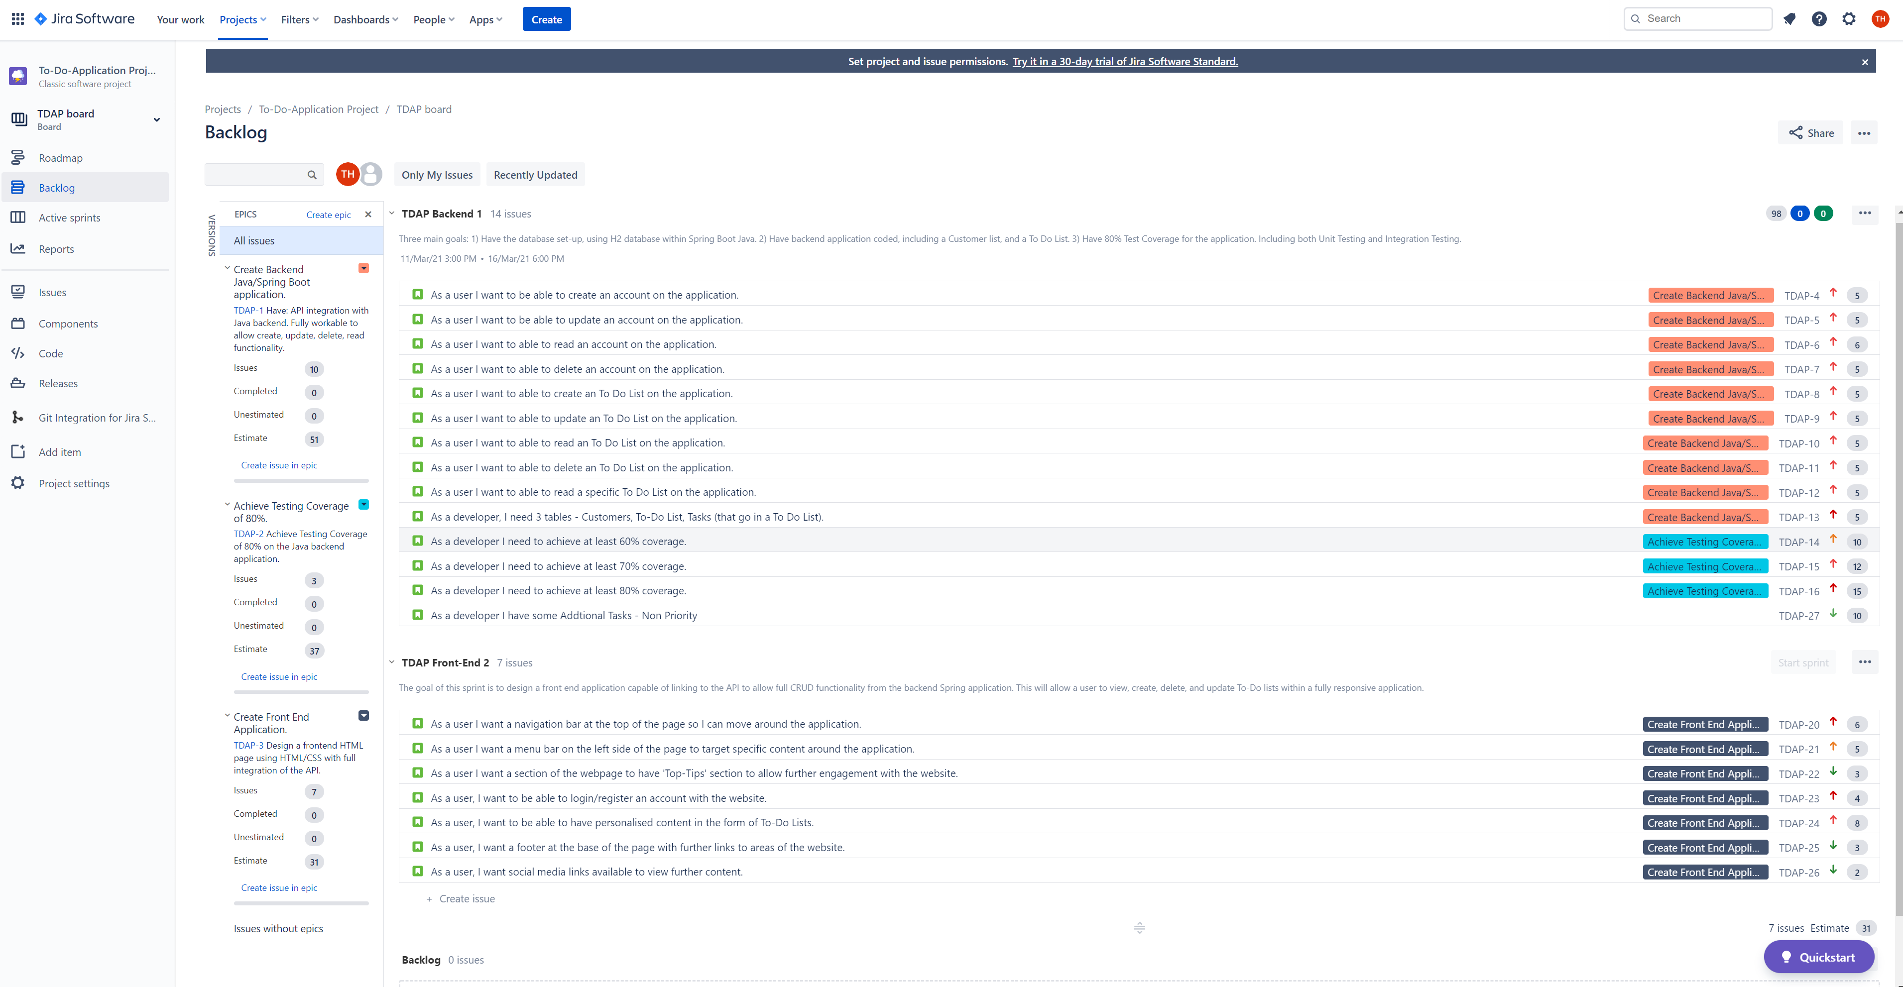
Project Management
Key Points
Two Sprints – One for backend, other for front end.
List of user stories, covering all CRUD functionality within the application.
Each user story has sub-tasks within, which needed to be achieved before moving the story into completed.
Each User Story was assigned to an epic.
Story points and priority was assigned. In cases where the Story points are the same are due to similar workload.

Slide 4
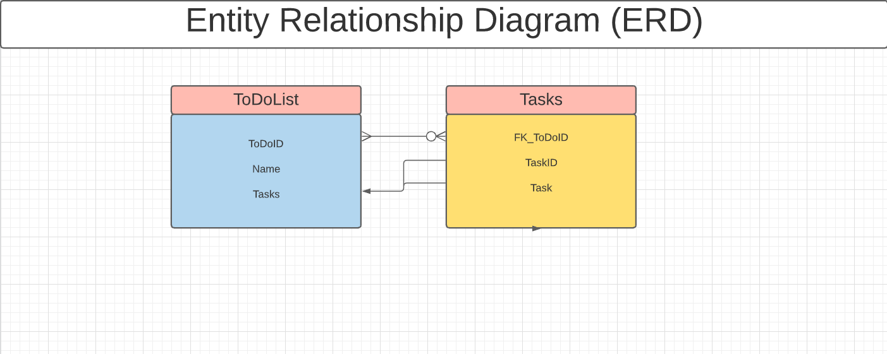
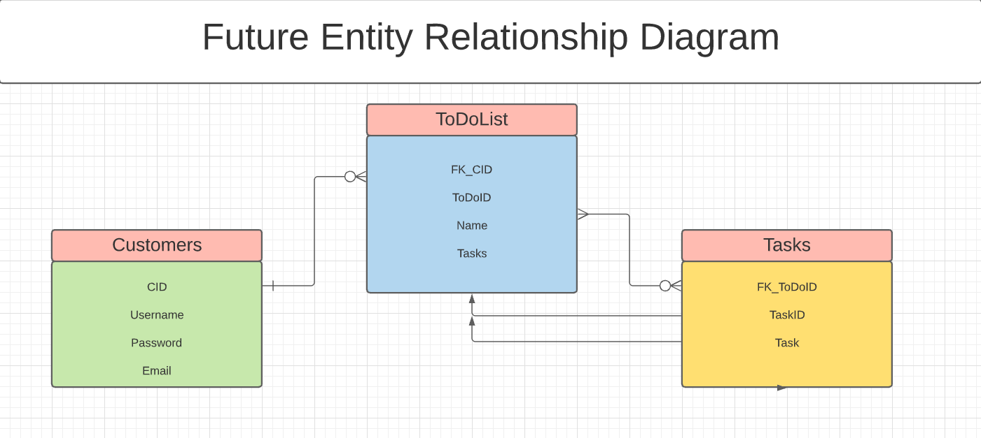
Entity Relationship Diagrams
I designed two Relationship diagrams. In the future I would like to add customer functionality to the program, making it so that when you sign in you get personalised content and personal lists.

Slide 5
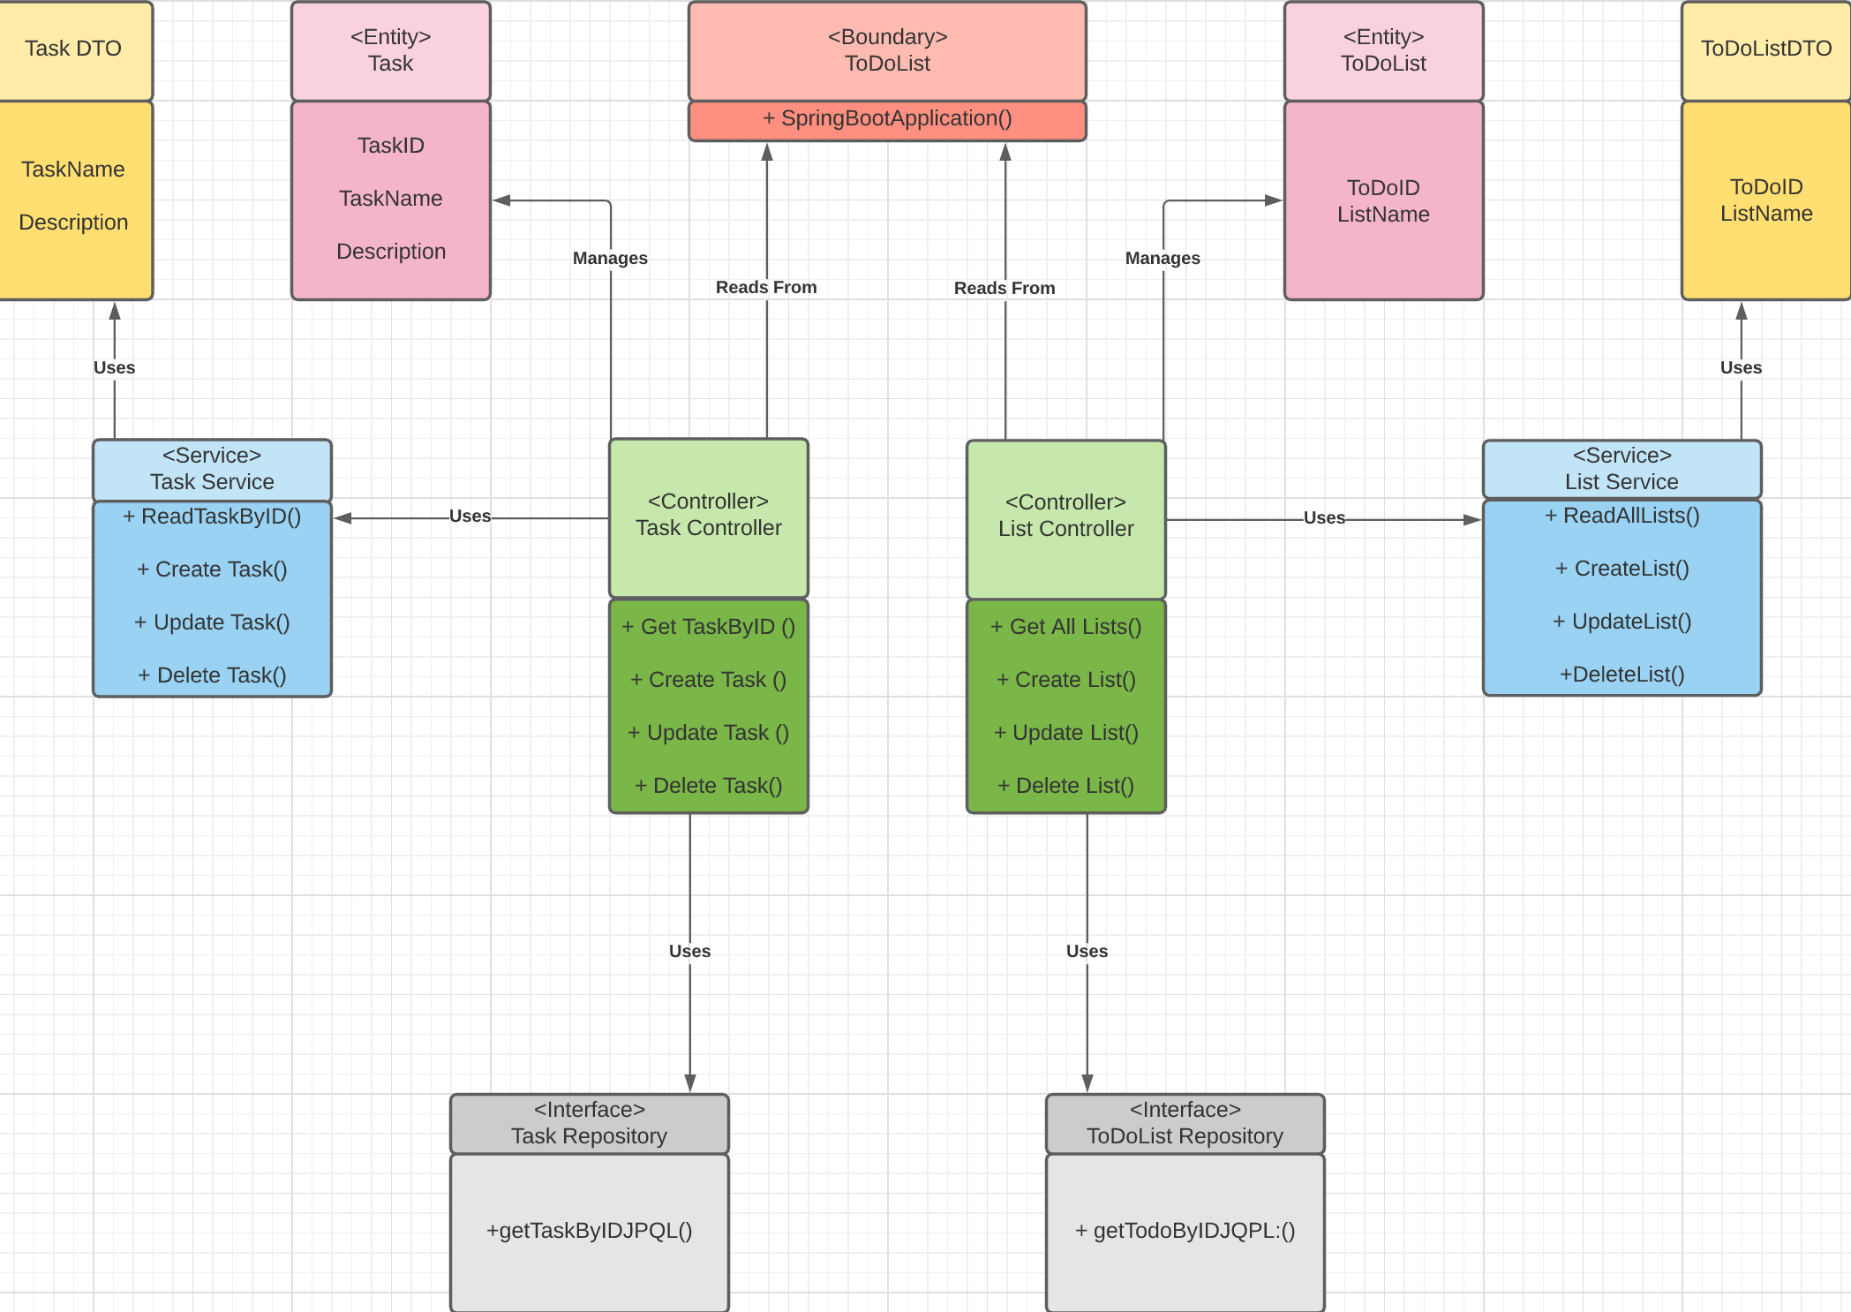
Unified Modelling Language (UML)

Slide 6
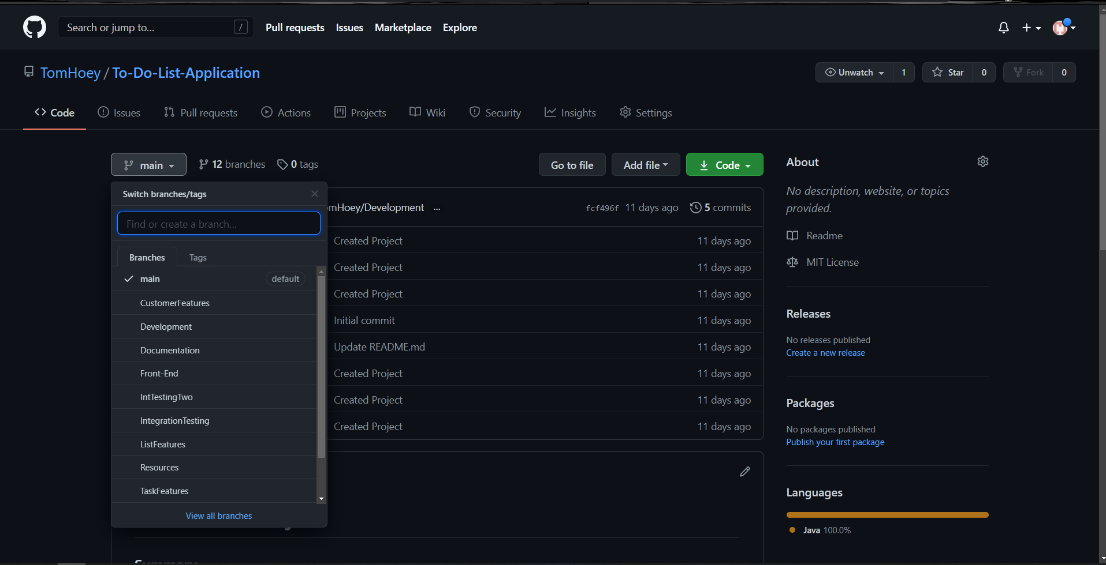
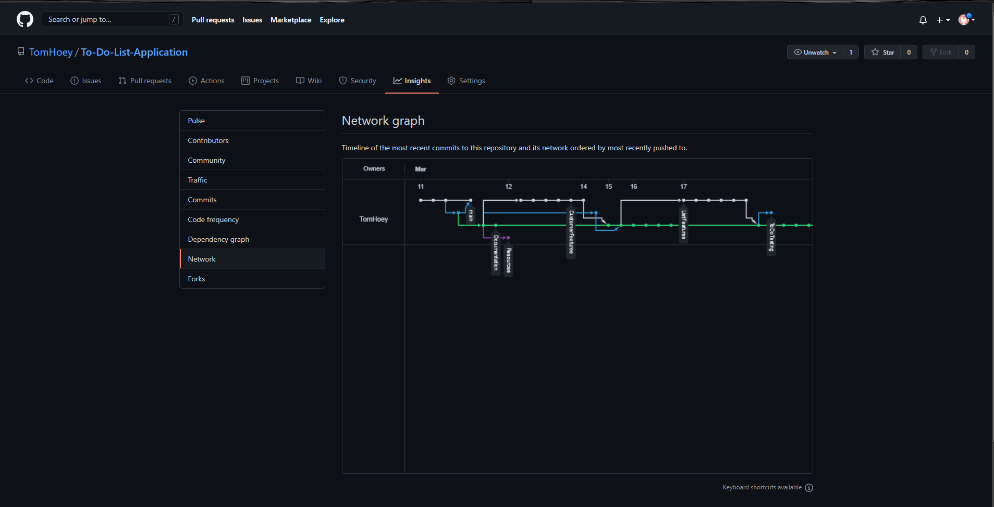
GitHub – Git - Branches
Using Git, I was able to create multiple feature branches as show in the image on the left.
From here I was able to test functionality before moving it back into Development Branch.
Image on the right shows the Network graph, as you can see there are multiple branches operating.

Slide 7
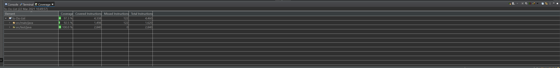
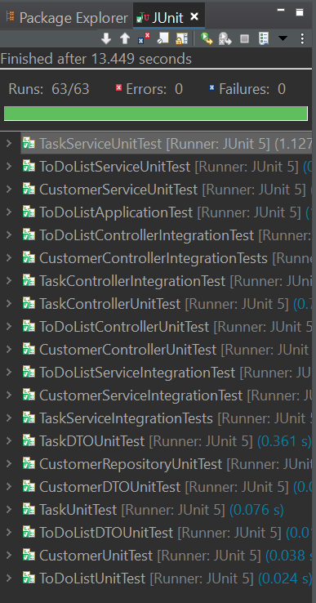
Testing and Coverage
I have full unit testing for Customers, Lists, and Tasks.
I have full integration testing for Lists and Tasks. The reason for this is the Customers doesn’t link to anything yet. That would be a future improvement of the system.
63 Tests in total. All running with zero errors.

Slide 8
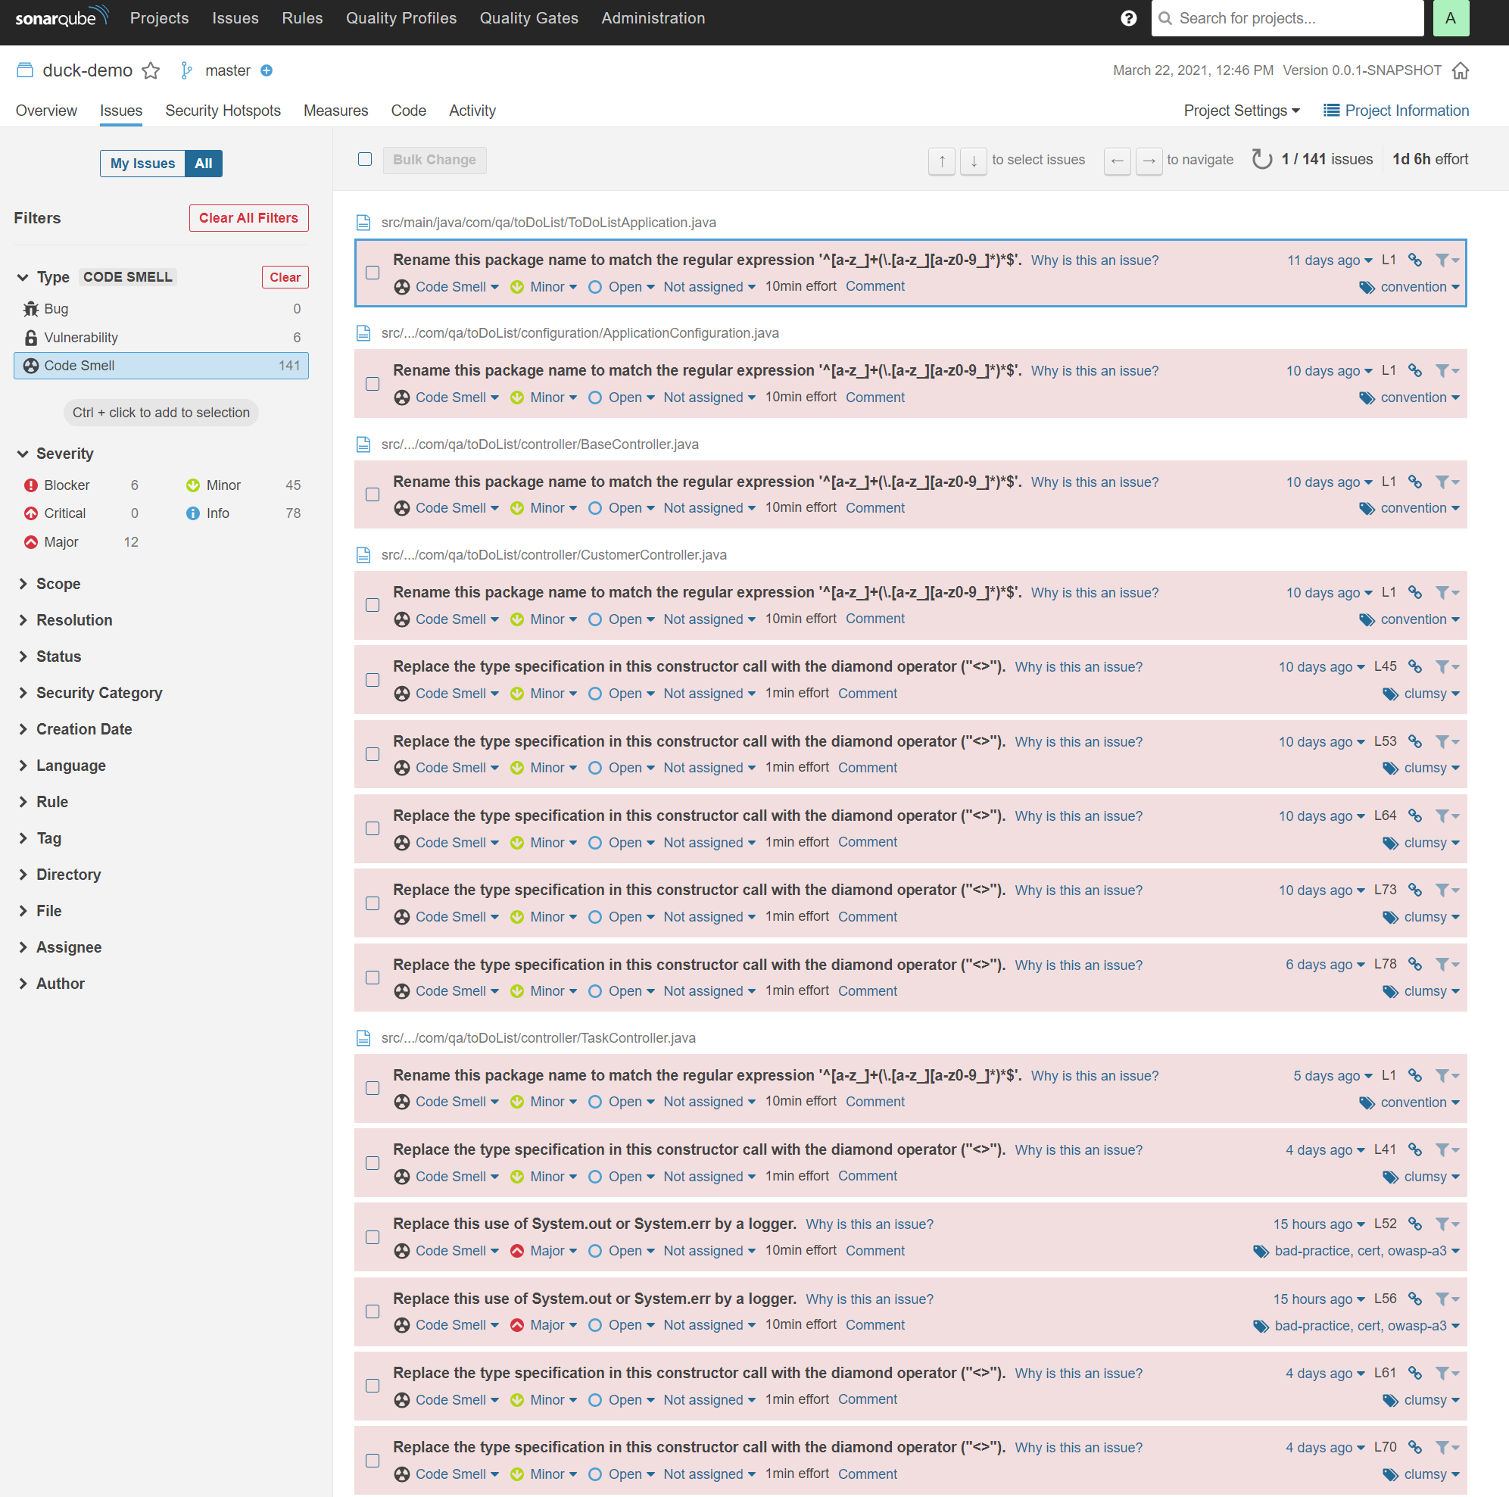
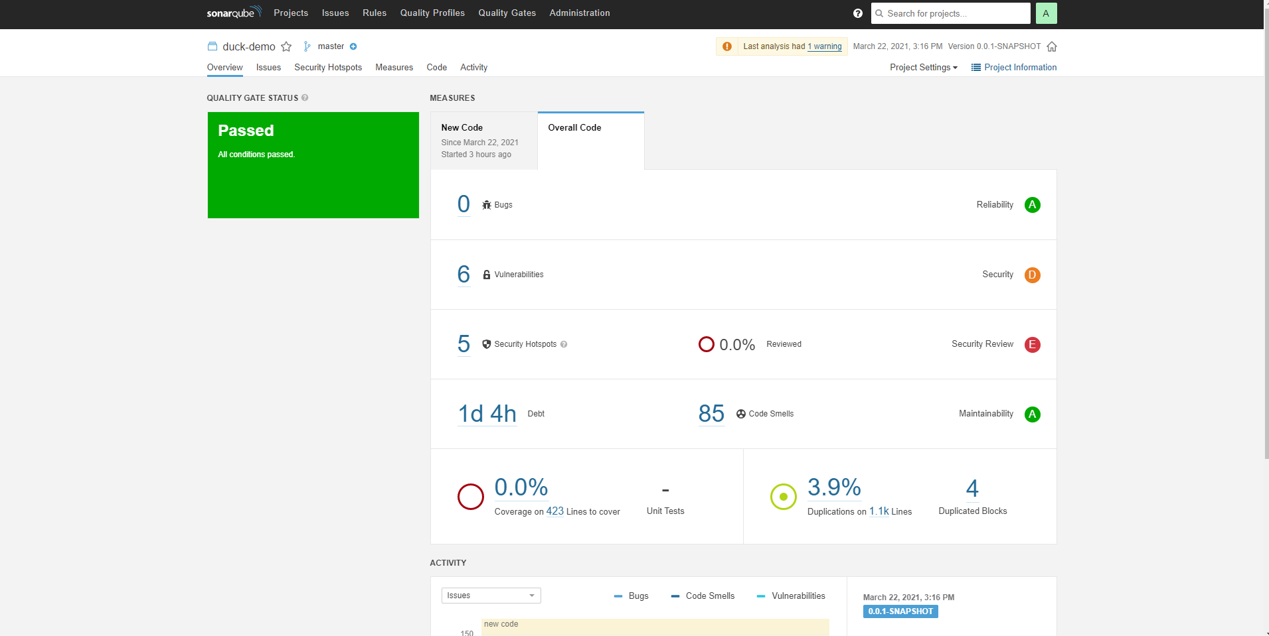
Sonar-cube
Due to the relatively late introduction of Sonar-Cube, I wasn’t fully able to implement the changes it suggested in my project.
With that being said, I have set up Sonar-Cube, and would be comfortable putting it into application.
I think the tool will be great for making me a better coder, it will help me spot the inefficiencies, tell me why, and how to fix them.

Slide 9
Closing Remarks
Positives
The project felt a lot cleaner than last time.
Plan of attack was far more efficient, testing as I went really helped with the flow.
Better understanding of tools and implementation of code was easier to understand.
Negatives:
Implementation of Selenium and Sonar-cube could have been a lot better.
With better understanding of the new technologies implementation could be quicker.
Spent far longer on the back-end, so didn’t really get to enjoy creating and designing the front-end as much as I would have liked.

Slide 10
Any Questions?

